Slide 1



Data Blending
View in Power BI
Last data refresh:
25/02/2021 09:01:41 UTC
Downloaded at:
09/05/2021 11:41:52 UTC

Slide 2
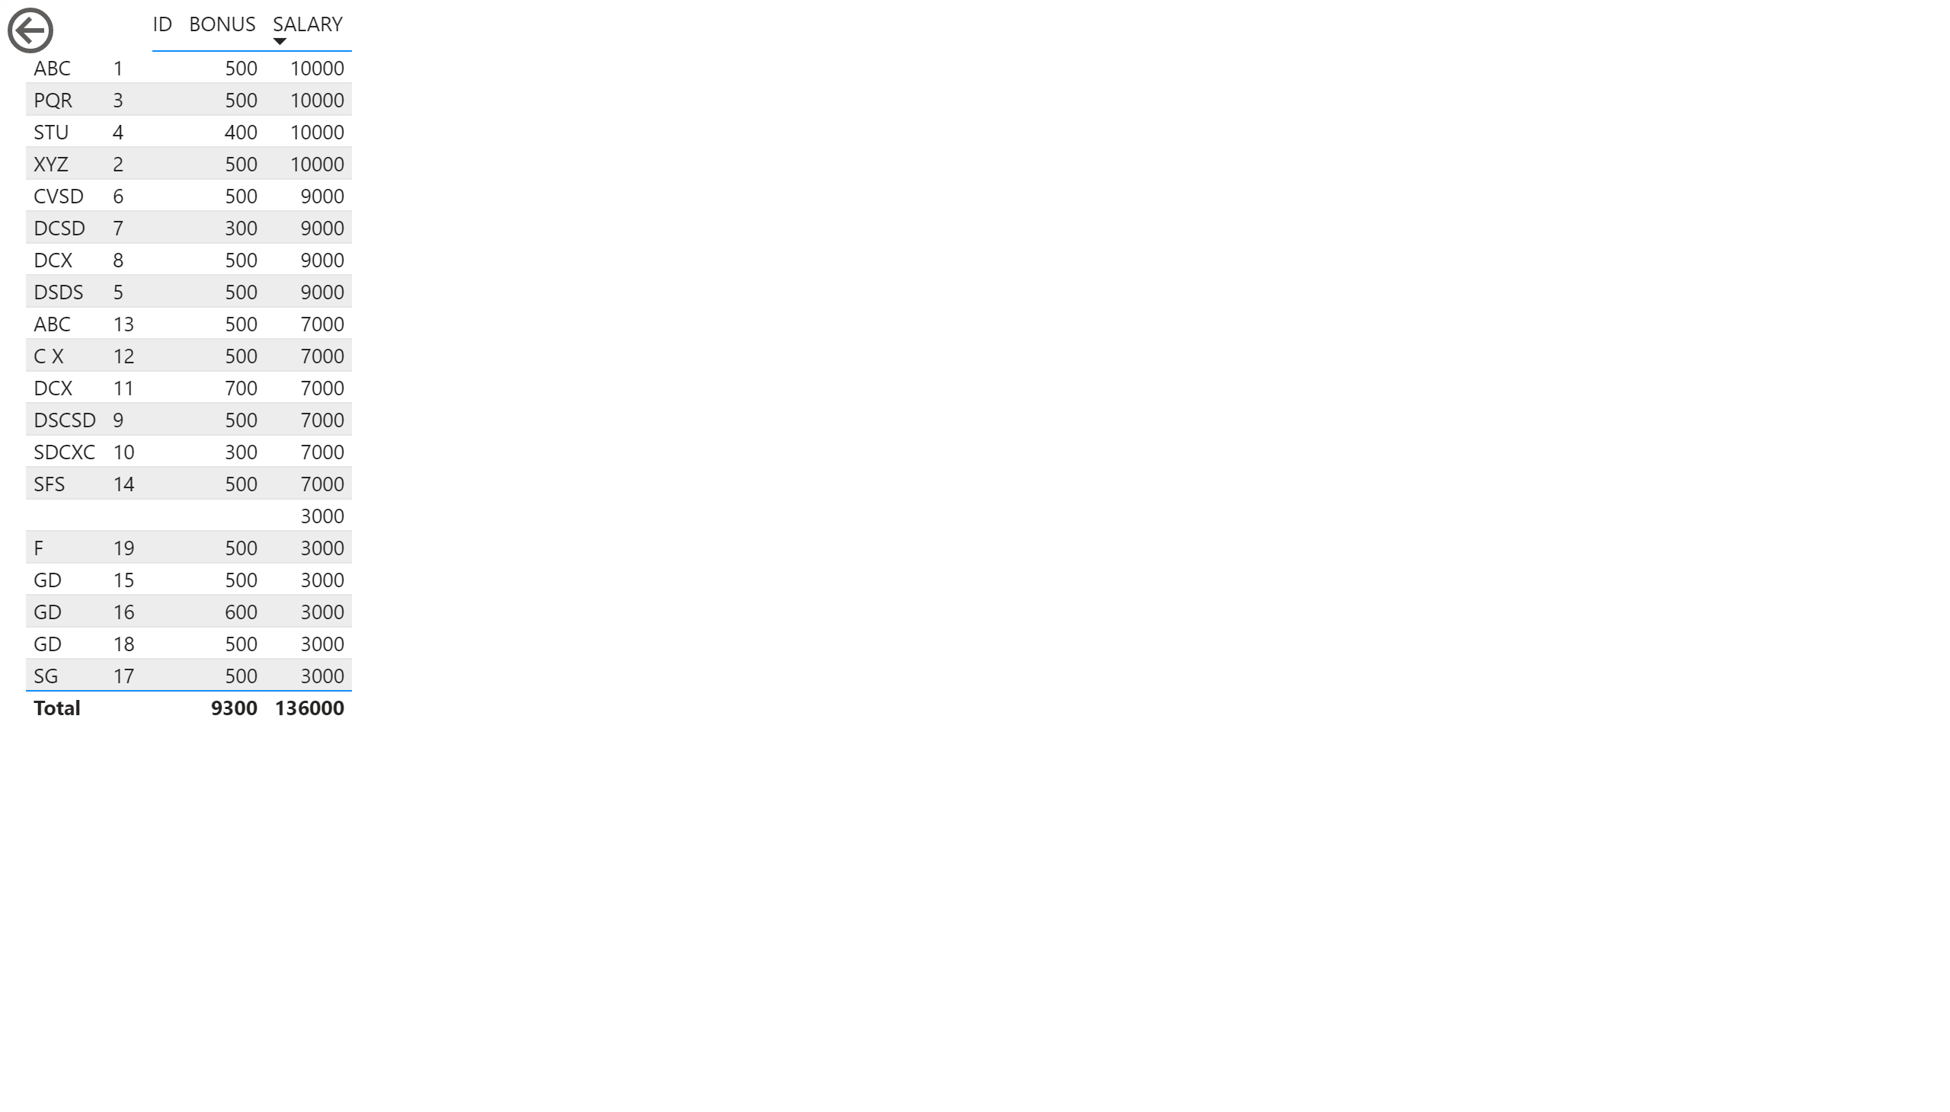
Page 1
Notes:
tableEx
No alt text provided.
actionButton
No alt text provided.

